Slide 1
LIBRARY MANAGEMENT
By
Neham Joe Baiju Sajid Hussain

Slide 2

SUBTITLE:
A Simple Book Management System
DESCRIPTION:
Introduction to Joey Library, a web app for managing a personal book collection.

Slide 3

OVERVIEW OF JOEY LIBRARY
OBJECTIVE:
Joey Library allows users to add, categorize, and delete books in their collection.
FEATURES:
Add new books with title, author, and category.
View books in a structured table.
Delete books as needed.
Search functionality for easy book lookup.

Slide 4

WEBSITE LAYOUT
NAVIGATION BAR:
A search bar for quickly locating books.
Logo and navigation links.

Slide 5
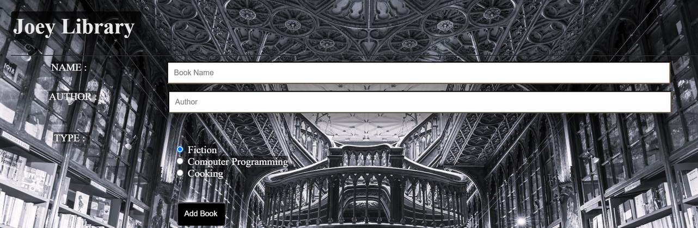

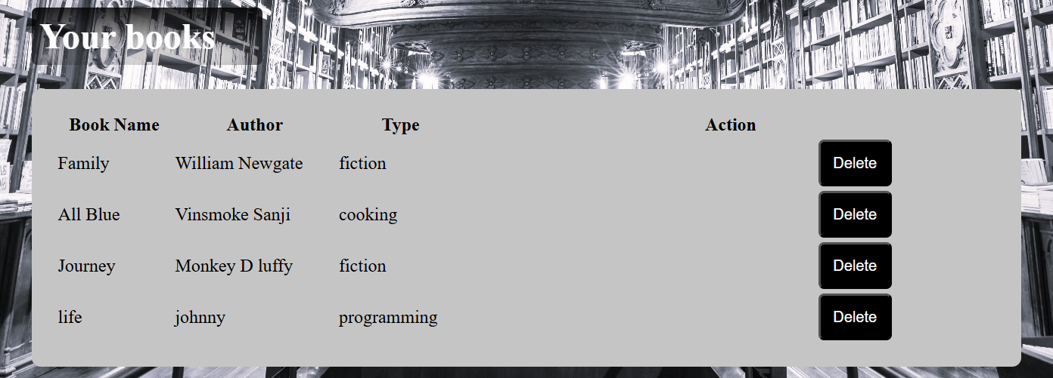

MAIN CONTENT:
Form for entering book details (title, author, category).
Table displaying the list of books.

Slide 6
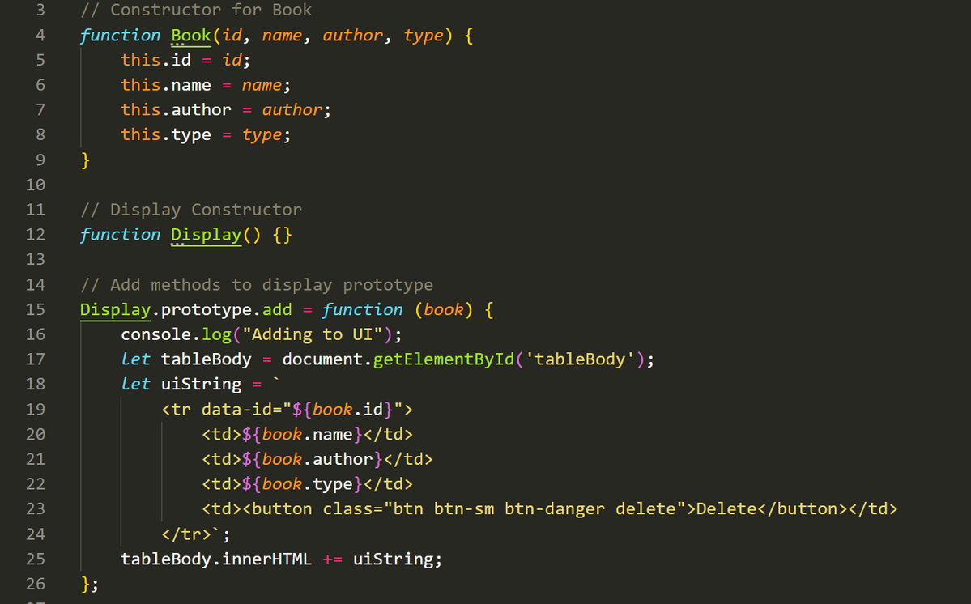

JAVASCRIPT - BOOK AND DISPLAY CONSTRUCTORS
This shows how the Book object is constructed and how the add function displays the book in the table.

Slide 7
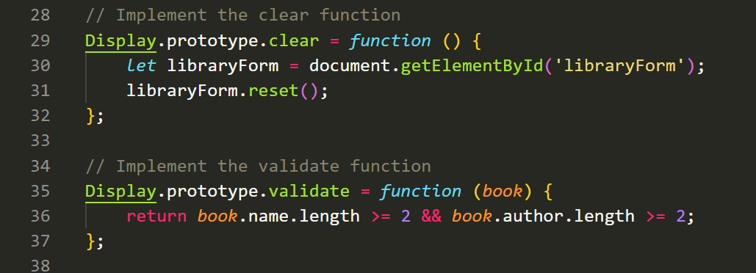

ADDING A BOOK - VALIDATION AND CLEAR METHODS
The validate method ensures the book details are complete, and clear resets the form.

Slide 8
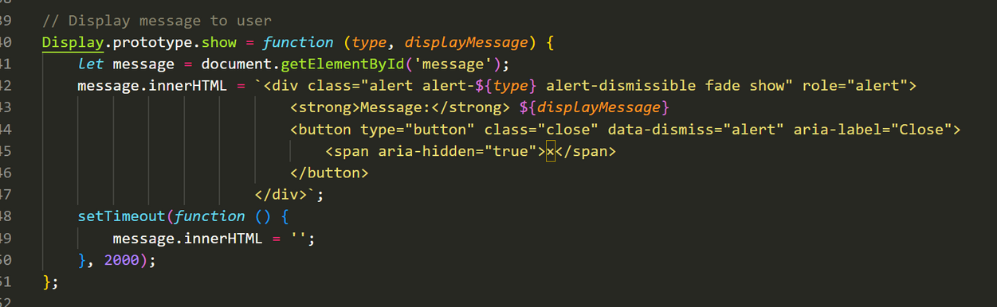
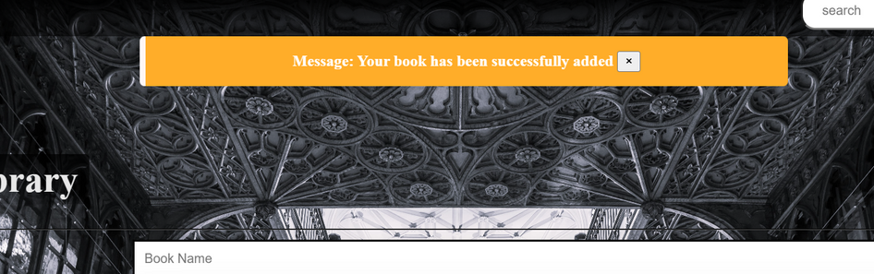

SHOWING USER MESSAGES
Displays success or error messages for feedback.

Slide 9
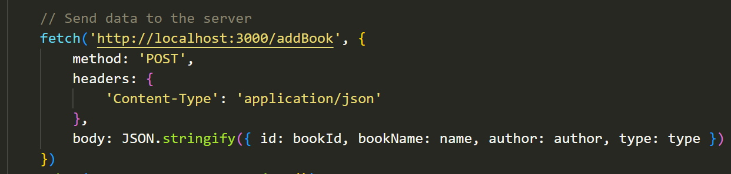

BACKEND INTERACTION - ADDING A BOOK
Sends the book data to a server for backend storage.

Slide 10
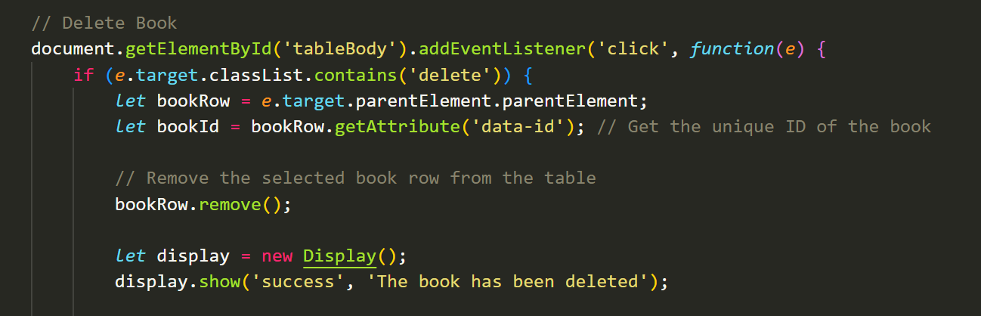


DELETING A BOOK
Handles deleting a book from the UI and sends a delete request to the server.

Slide 11


SUMMARY AND FUTURE ENHANCEMENTS
Summary:
Joey Library’s features for adding, categorizing, and deleting books.
Future Enhancements:
Additional categories, enhanced search, and an editing option.

Slide 12
THANK YOU

